Slide 1
The weather dataset
(Weather Insights with NumPy & Pandas)
By : Syed Ulfa

Slide 2

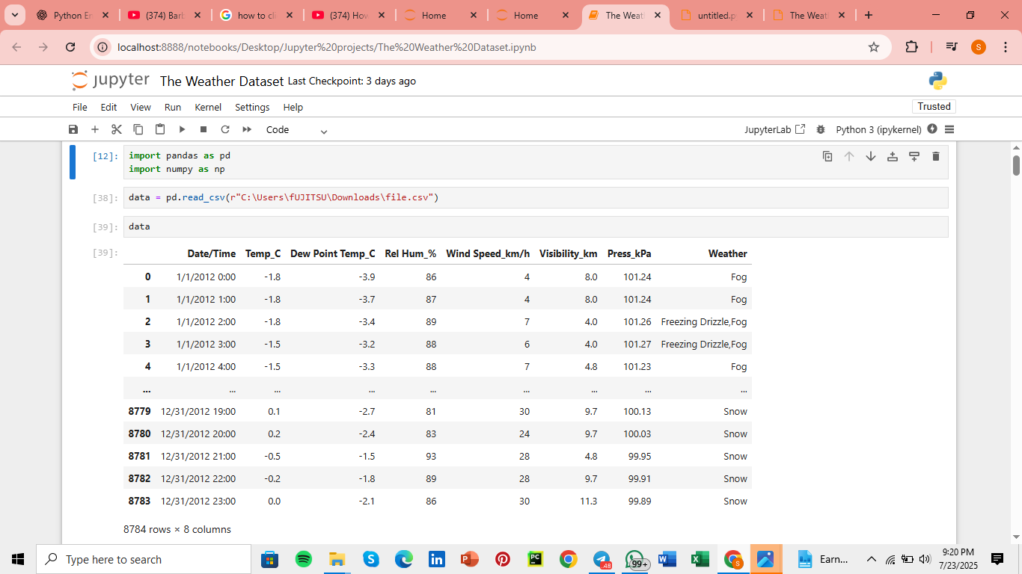
Import Pandas and NumPy library

Slide 3
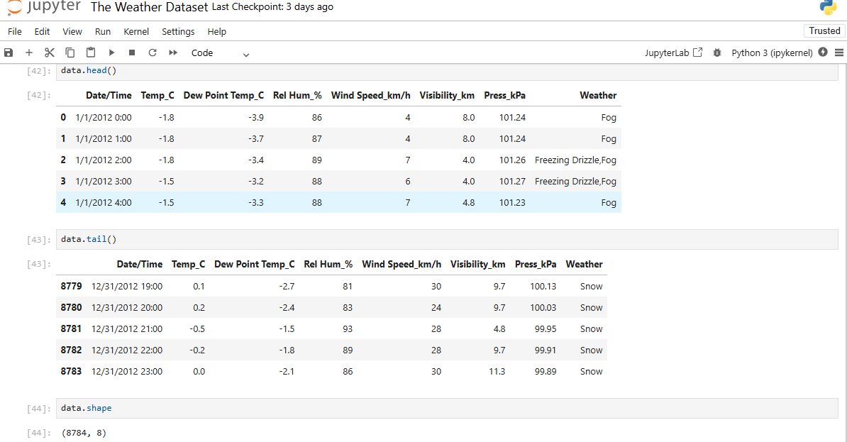
Used Exploratory Data Analysis to inspect data structure

Slide 4
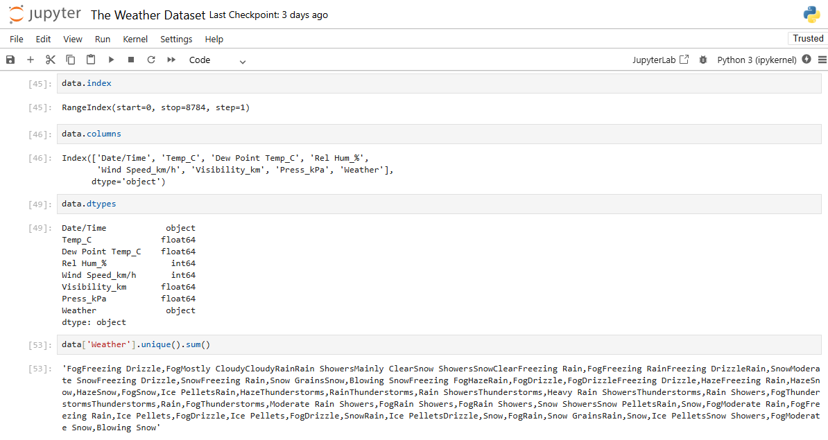
Used Exploratory Data Analysis to inspect data structure

Slide 5
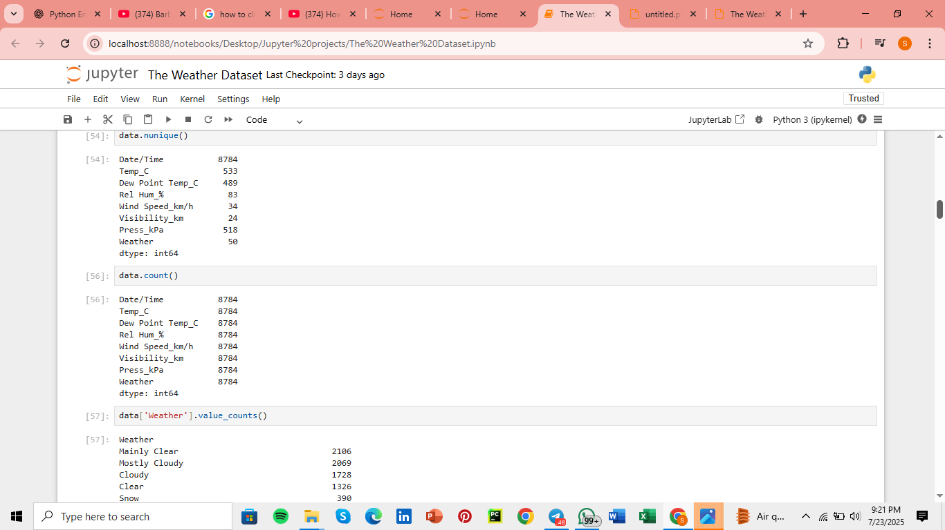
Identified the most frequent weather conditions

Slide 6
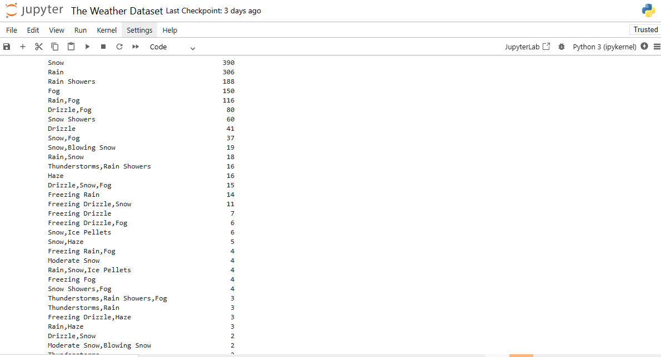
Used Exploratory Data Analysis to inspect data structure

Slide 7
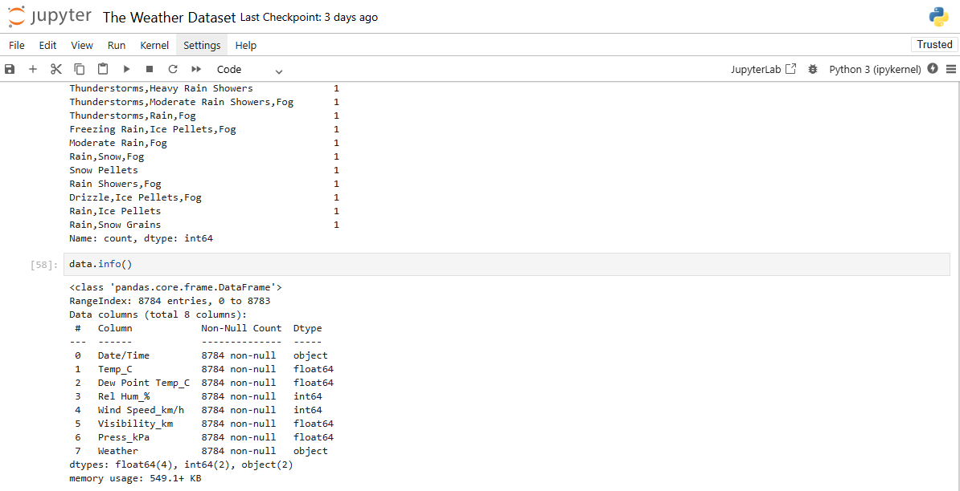

Slide 8
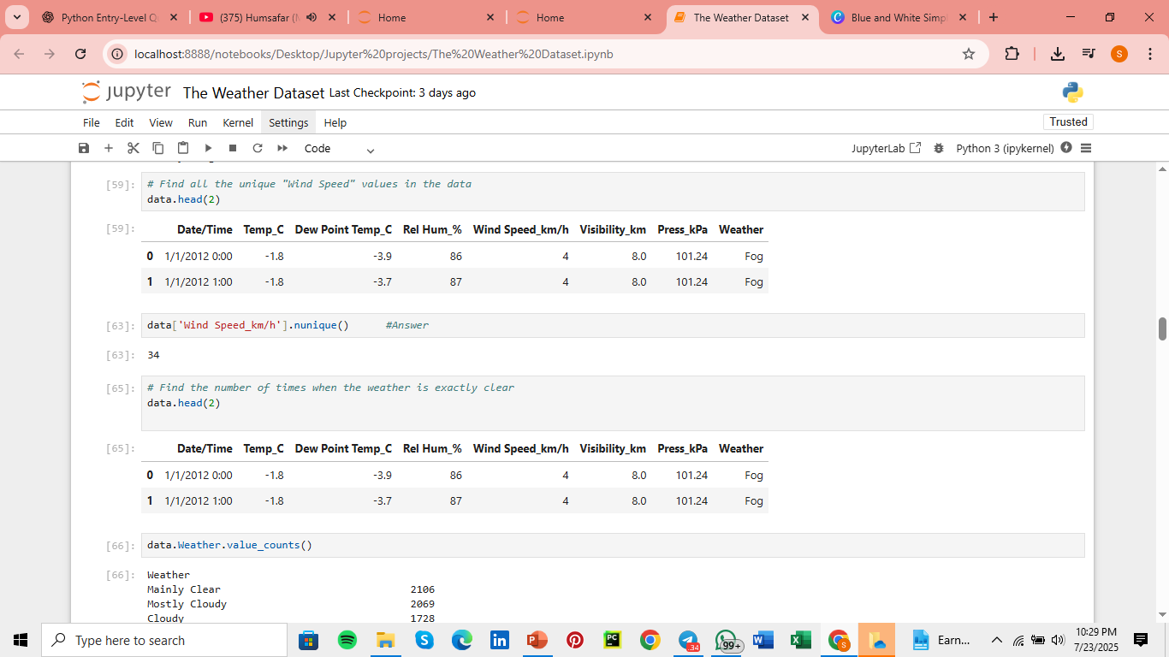

Find all the unique “Wind Speed” values in data

Slide 9
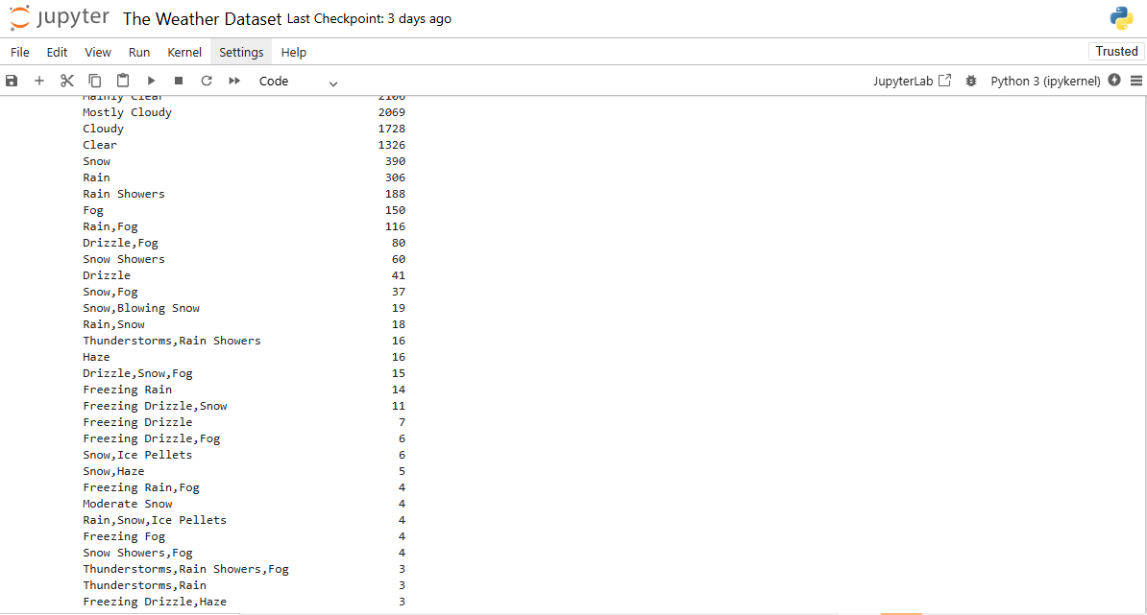


Slide 10
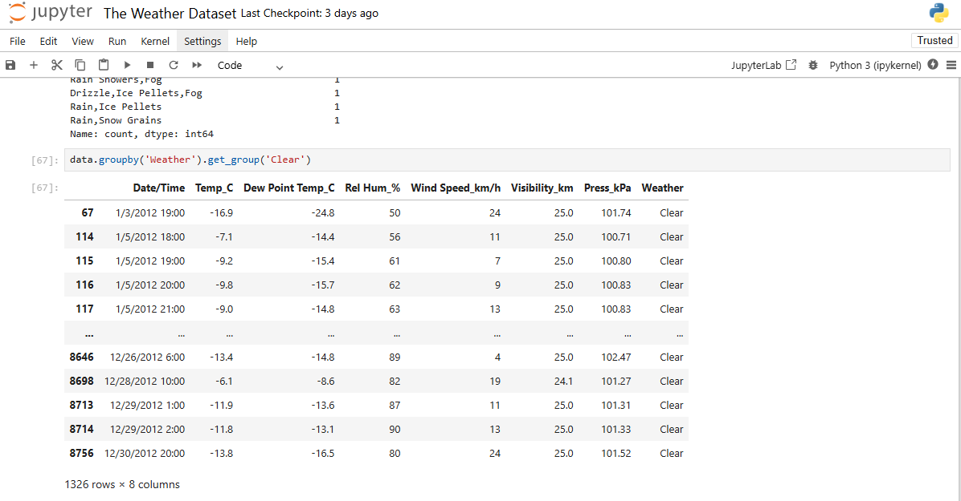
Group by weather column with the weather status as ‘CLEAR’
Learn to infuse energy into your delivery to leave a lasting impression
One of the goals of effective communication is to motivate your udience

Slide 11
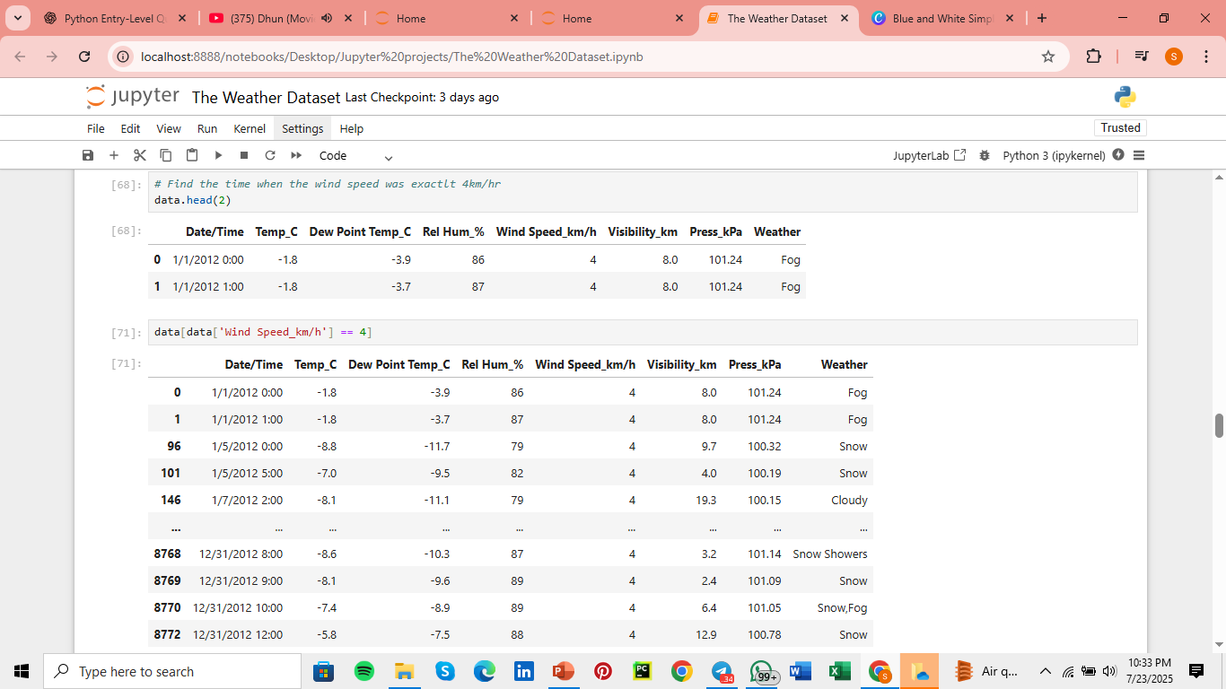
Find the time when the wind speed was exactly 4km/hour

Slide 12
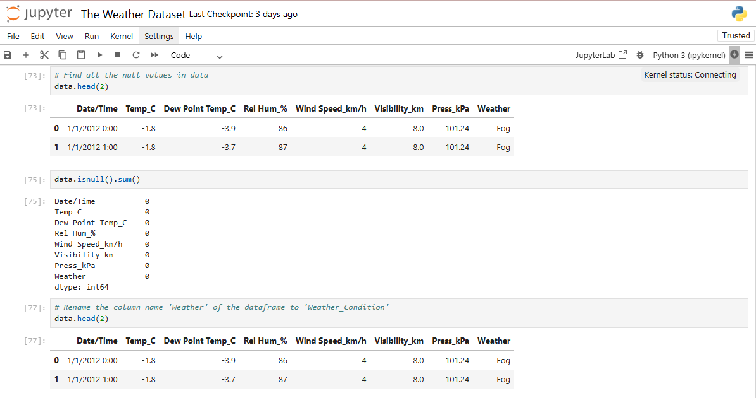
Find the NULL values in data

Slide 13
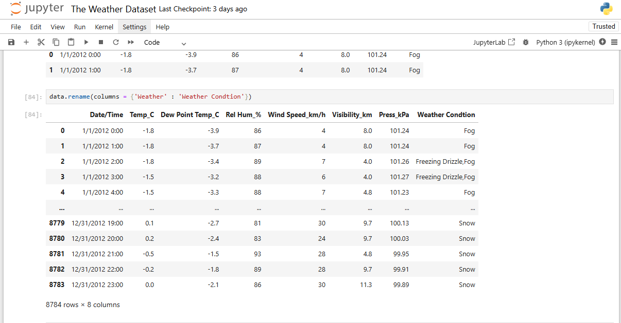
Thank you
Rename the column name from ‘Weather’ to ‘Weather Condition’
Brita Tamm
502-555-0152
brita@firstupconsultants.com
www.firstupconsultants.com

Slide 14
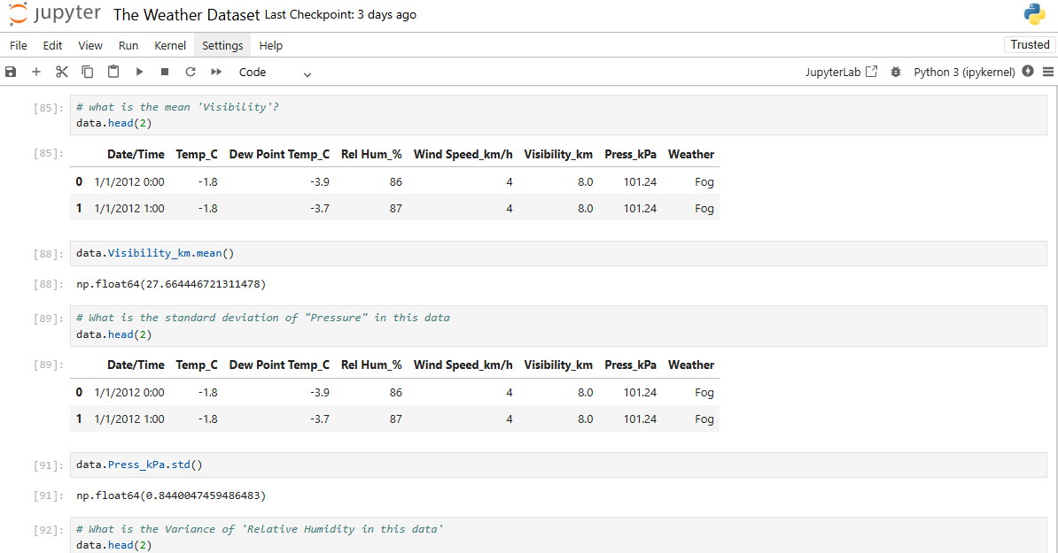
What is the mean of ‘Visibility’?
What is the standard deviation of ‘Pressure’?

Slide 15
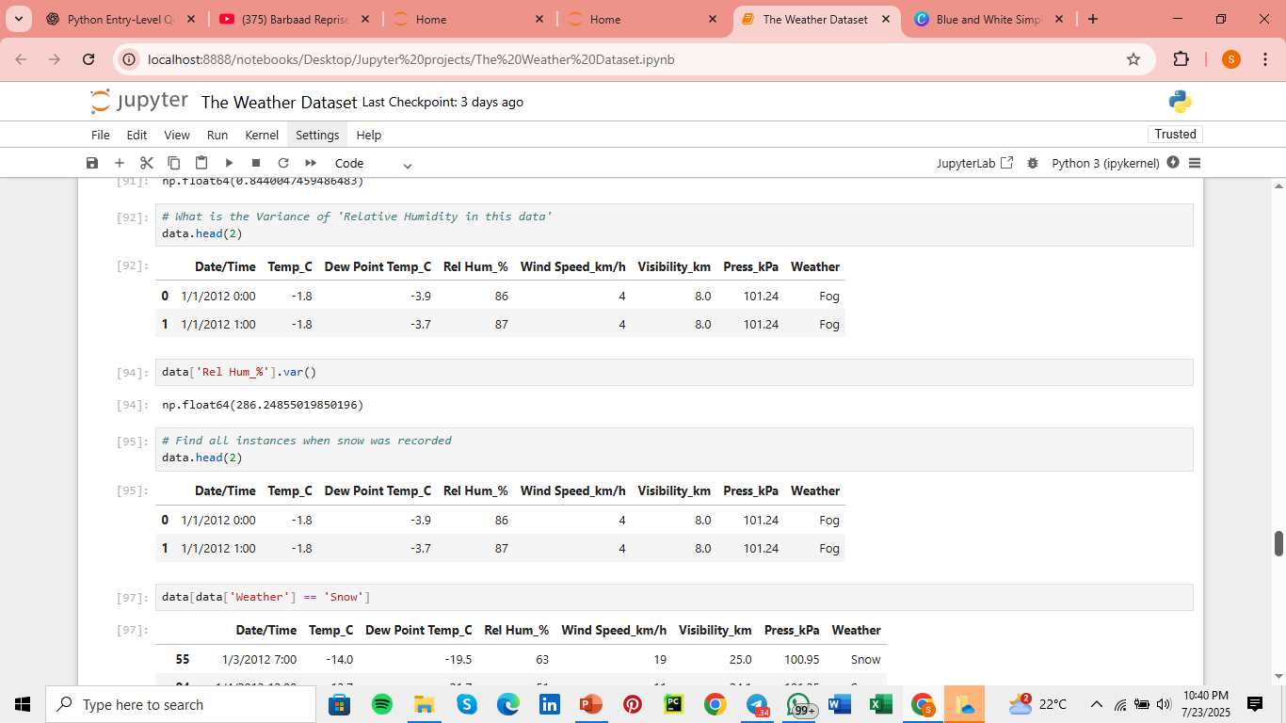
What is the variance of ‘Relative Humidity’ ?
Find all the instances when snow was recorded

Slide 16
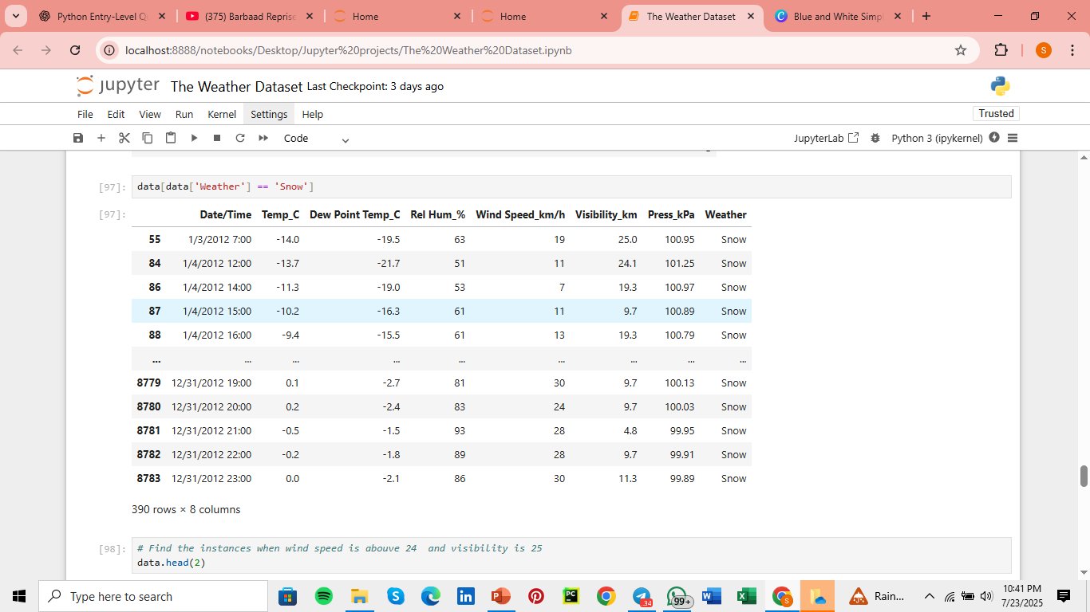

Slide 17
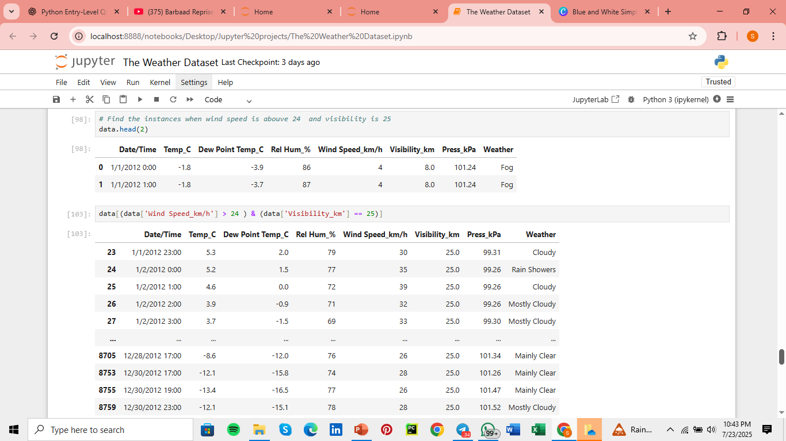
Find all the instances when wind speed is above 24 and visibility is 25

Slide 18
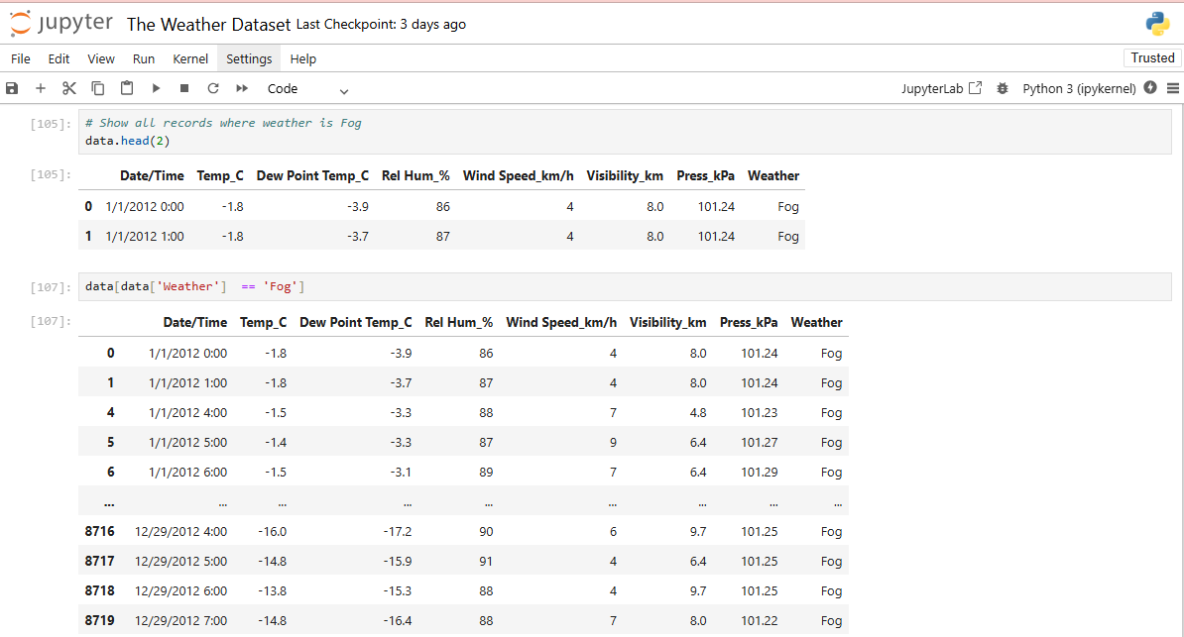
Show all the records where weather is ‘FOG’

Slide 19
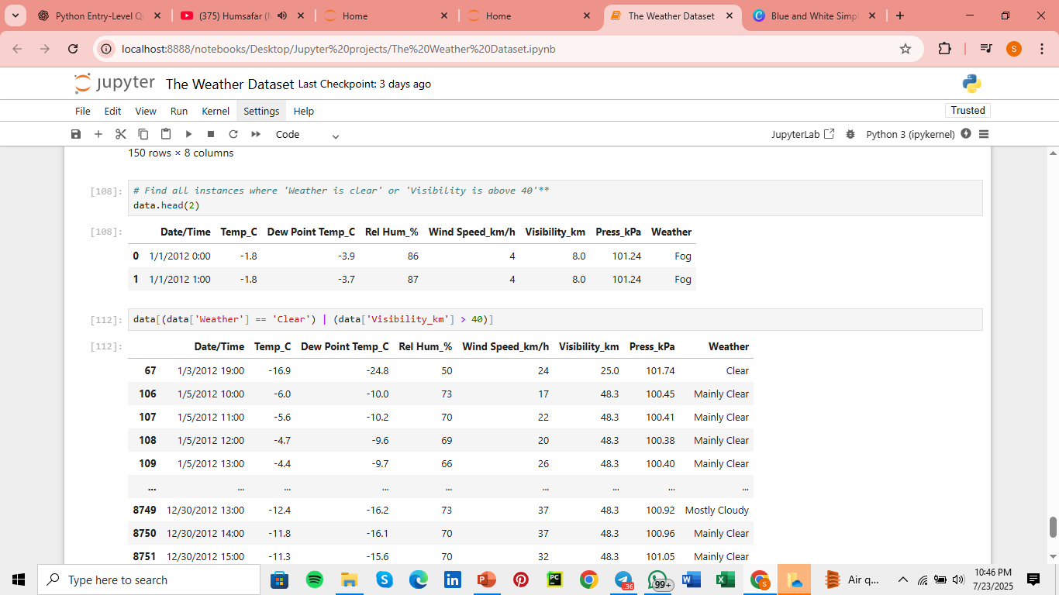
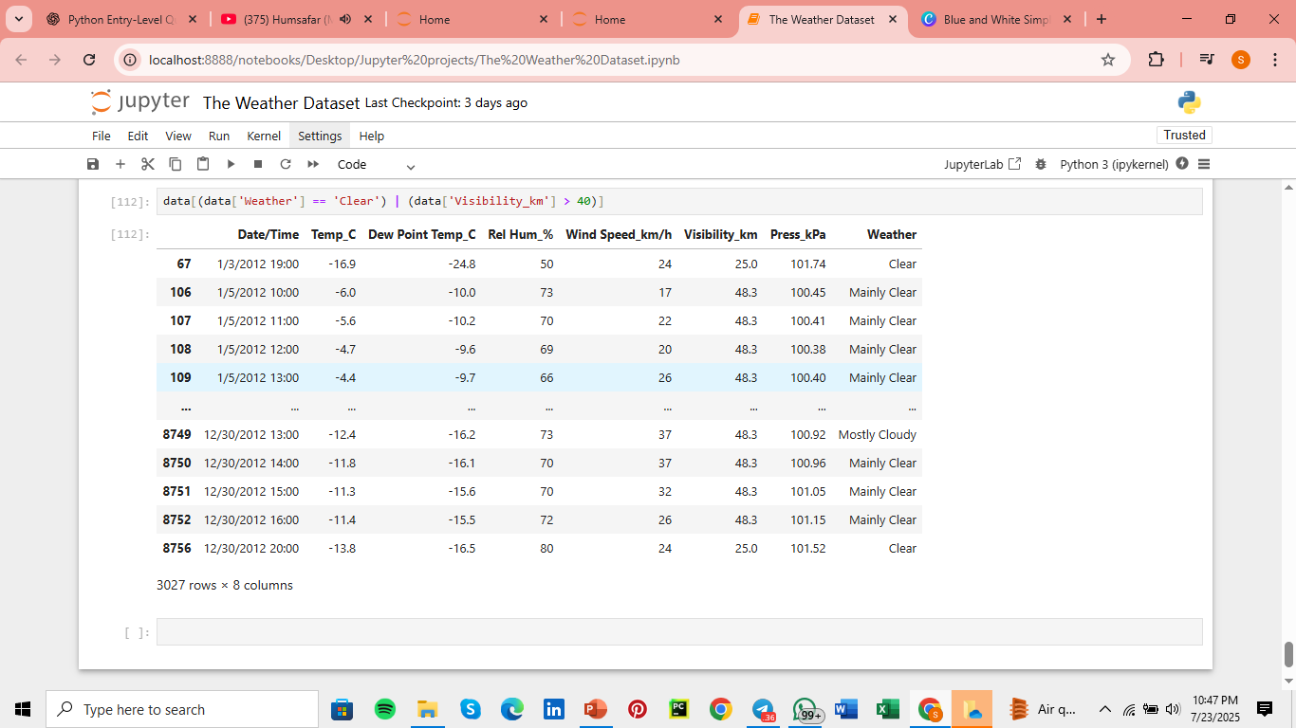
Find all the instances where ‘ weather is clear or visibility is above 40

Slide 20
Objectives:
To explore and analyze weather data using Python libraries like Pandas and NumPy
To perform Exploratory Data Analysis (EDA) to understand patterns, trends, and anomalies in the dataset
To identify and answer specific weather-related questions (e.g., wind speed conditions, visibility ranges, weather status)
To demonstrate basic data cleaning tasks like renaming columns and handling null values
To showcase the use of Python in drawing meaningful insights from real-world weather data

